Slide 1
Bias in ML
challenges and opportunities in the context of HR and recruiting
ML6
Matthias Feys

Slide 2
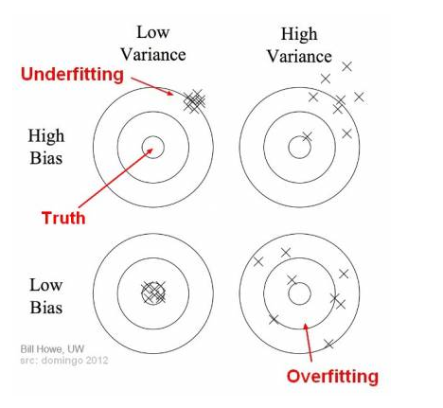
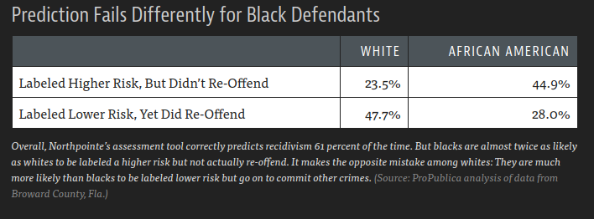
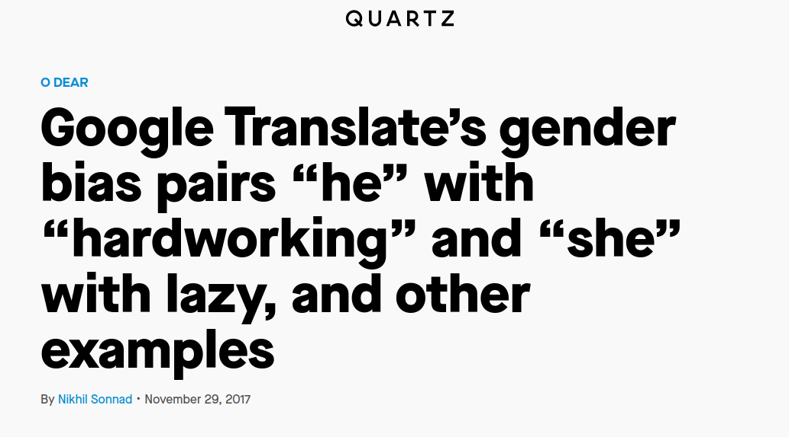
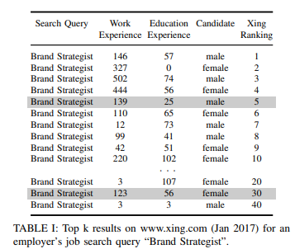
What is Bias in ML?

Slide 3
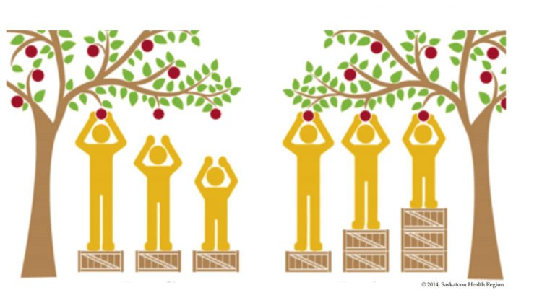
Many definition of Fairness
Unawareness
Group fairness
Individual fairness
→ No “best” definition of fairness
Notes:
Demographic Parity, Equalized Odds, and Predictive Rate Parity fall into a larger category called “group fairness”

Slide 4
Unawareness
Don’t include sensitive variable as a feature in the training data
simple to implement
doesn’t require knowledge of the sensitive variable
proxies of the sensitive variable are not excluded
Notes:
Demographic Parity, Equalized Odds, and Predictive Rate Parity fall into a larger category called “group fairness”

Slide 5
Group Fairness
Sensitive variable divides individuals into two groups, each group should be treated “equal”
excludes potential proxy features
definition of “equal” is contradictory
prone to positive discrimination (lazy implementation)
Notes:
Demographic Parity, Equalized Odds, and Predictive Rate Parity fall into a larger category called “group fairness”

Slide 6
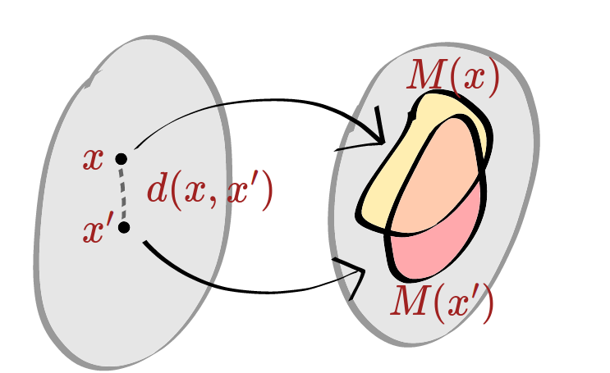
Individual Fairness
Similar individuals should be treated similarly, implemented by analysing pairs of individuals
most fine-grained fairness
ambiguous definition of similarity
Notes:
Demographic Parity, Equalized Odds, and Predictive Rate Parity fall into a larger category called “group fairness”

Slide 7
Many definition of Fairness
Optimizing for any definition improves the status quo
Impossible to optimize for all, possible to calculate all
→ multiple tools exist to help you with this (Google What-if, IBM AI Fairness 360, ...)
Monitoring fairness is the first step
Notes:
Demographic Parity, Equalized Odds, and Predictive Rate Parity fall into a larger category called “group fairness”

Slide 8
Causes of Bias
sample bias
prejudicial bias
exclusion bias
measurement bias
algorithmic bias
Notes:
man bias existing in training dataset due to historical reason

Slide 9
Causes of Bias
sample bias
prejudicial bias
exclusion bias
measurement bias
algorithmic bias
introduced by the dataset
introduced by the model
→ Mainly due to human bias existing in the training data.
Notes:
man bias existing in training dataset due to historical reason

Slide 10
Bias mitigation algorithms
Reducing bias in the data (pre-processing)
Reducing bias in the classifier (training)
Reducing bias in the predictions (post-processing)
training data
model training
inference

Slide 11
Reducing bias in the data
Sampling or re-weighting the data
Modify features or labels (obfuscate information about protected attributes)
training data
model training
inference

Slide 12
Reducing bias in the classifier
Add a discrimination-aware regularization term to the learning objective
Adversarial debiasing: maximize accuracy while reducing evidence of sensitive features in the predictions
training data
model training
inference

Slide 13
Reducing bias in the predictions
Changes predictions from a classifier to make them more fair
Works with black box models and unknown datasets
training data
model training
inference

Slide 14
Bias mitigation algorithms
3 main types of solutions
Trade-off between accuracy and fairness
Typically need sensitive features to achieve fairness

Slide 15
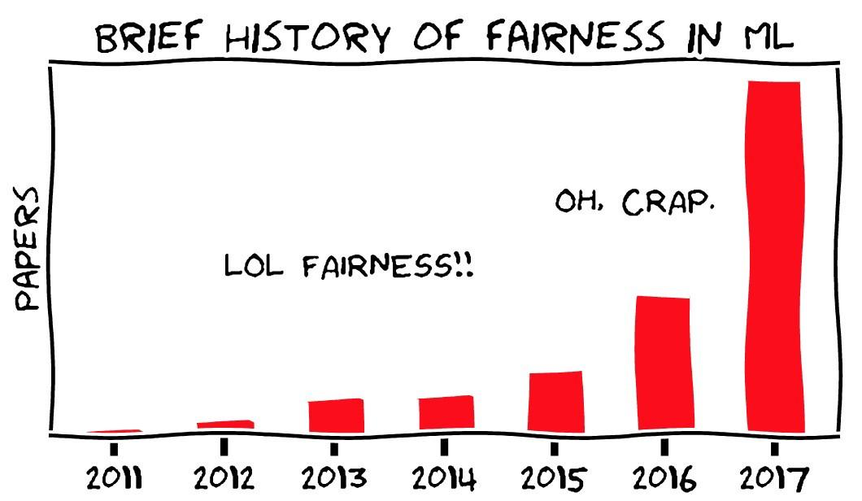
Looking forward
Fairness/bias is on the map
New papers
New tools
Work on legal context
“If you can measure it, you can improve it”
vs.
“You get what you measure”

