Slide 1
Case Study
Using NLP for detecting
early-onset Alzheimer’s
Faktion pro-bono project
Jos Polfliet, VP of Applied AI

Slide 2
FAKTION — we put thought into everything
We build
Deep Learning,
Machine Learning and
Artificial Intelligence
solutions
2019 EUROPEAN
CTO OF THE YEAR
2019 BELGIAN
AI SCALE-UP OF THE YEAR
Antwerp Belgium
Singapore Singapore
3,5m*
Turnover
53*
fte
* FY 2018-2019

Slide 3
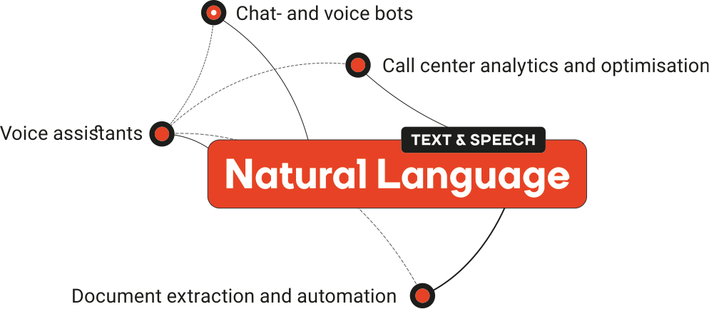
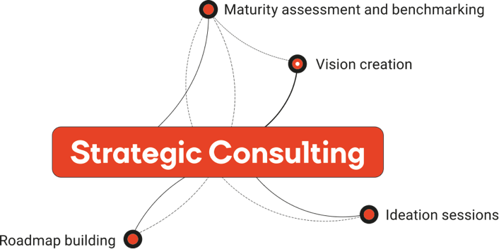
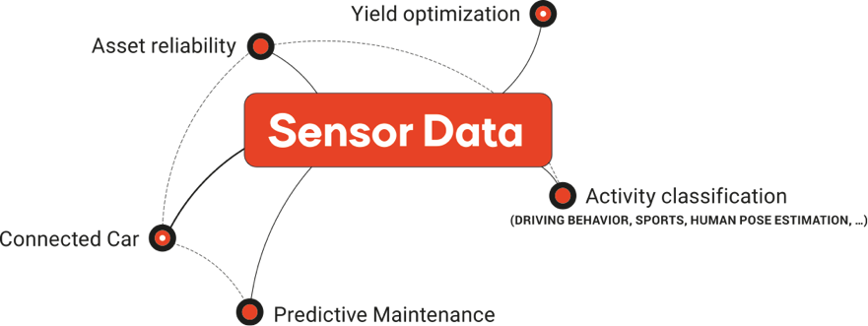
FAKTION — we put thought into everything
Faktion is an applied AI service provider.
We build custom software applications
with Machine and Deep Learning technology.
Due to the strong extent of our experience, we share that by means of strategic consulting.

Slide 4
Alzheimer’s progression
Healthy
Mild cognitive impairment
Stage 1:
Mild
Stage 2:
Moderate
Stage 3:
SEVERE
Up to 10 years before first symptoms Memory lapses noticeable to very close family/friends Normal life continues Toxic changes in the brain | Misplacing items Language problems like coming up with the right words Losing a sense of time Poor judgment and personality changes Withdrawal | Increase memory loss and confusion Trouble recognizing family and friends Loss of impulse control Loss of writing and reading skills | Around the clock care needed Failure to recognize family and friends Severe physical problems like incontinence, difficulty swallowing

Slide 5
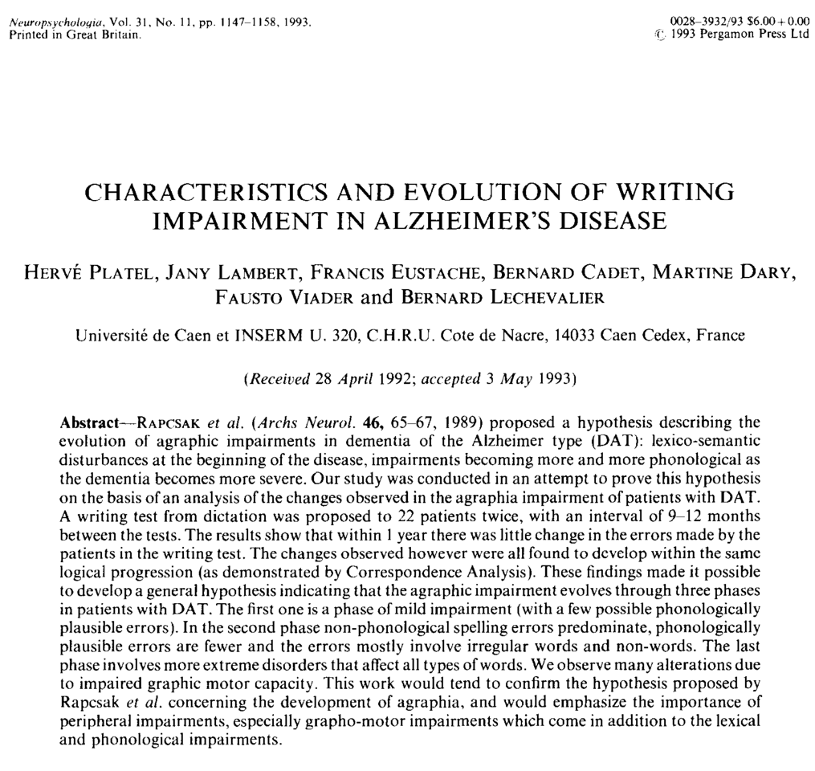
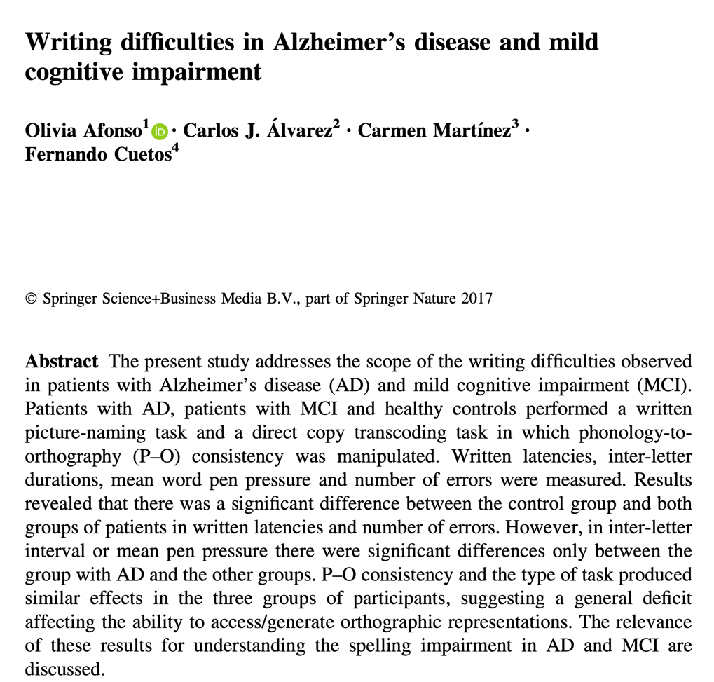
Notes:
Known.

Slide 6
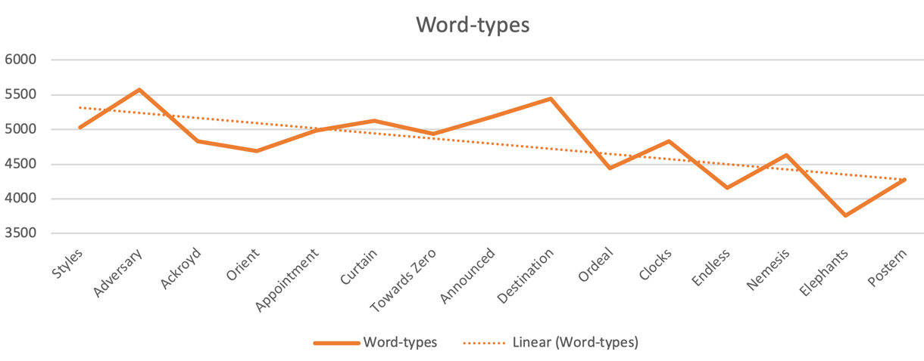
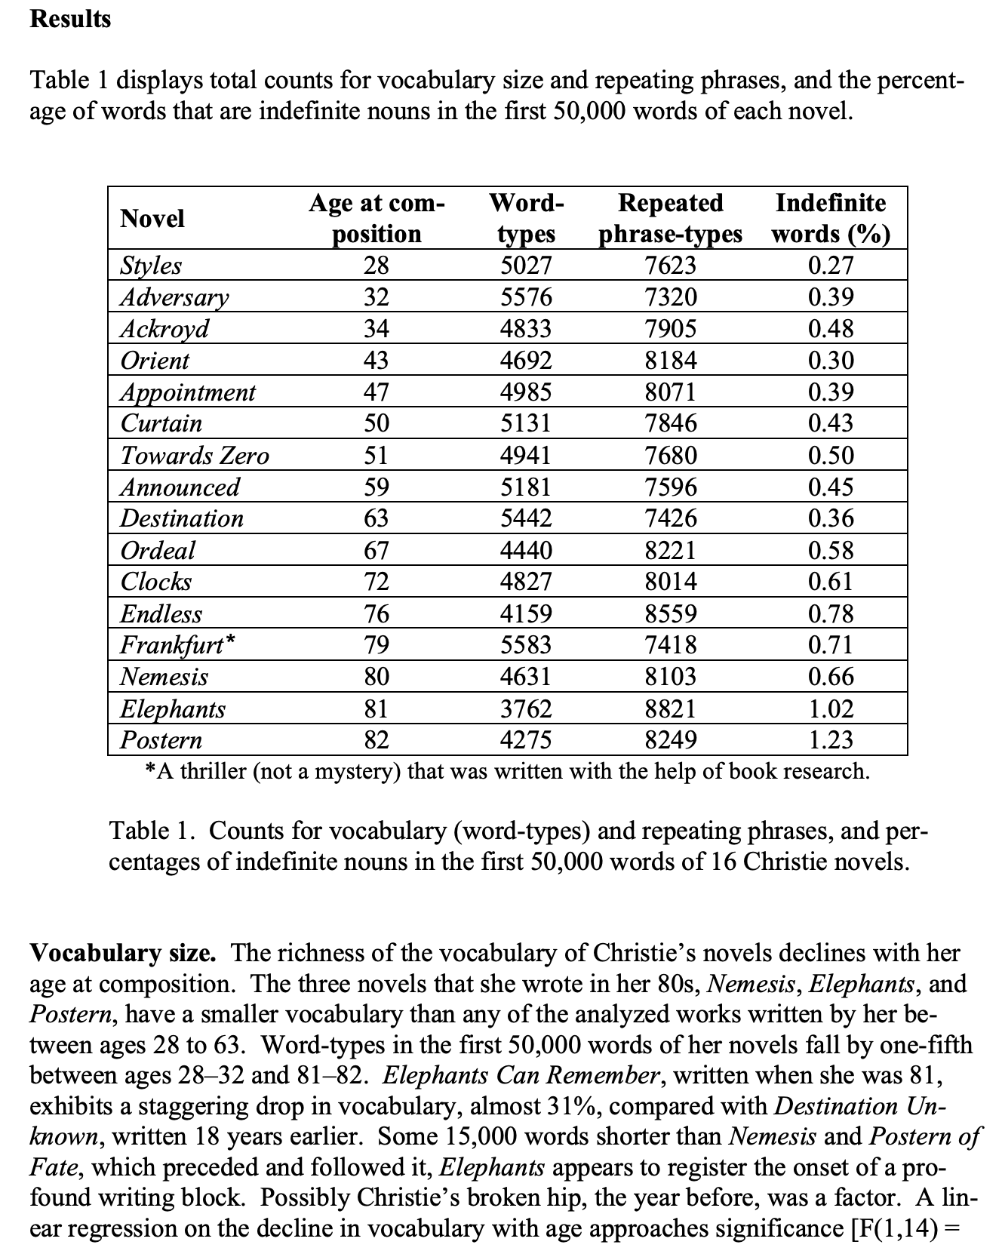
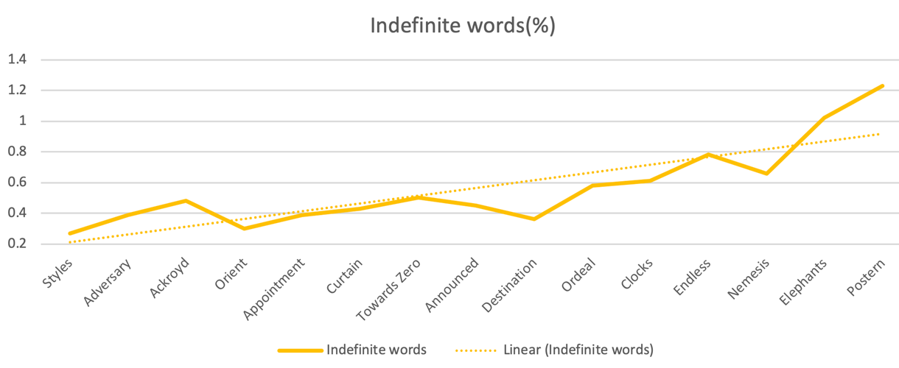
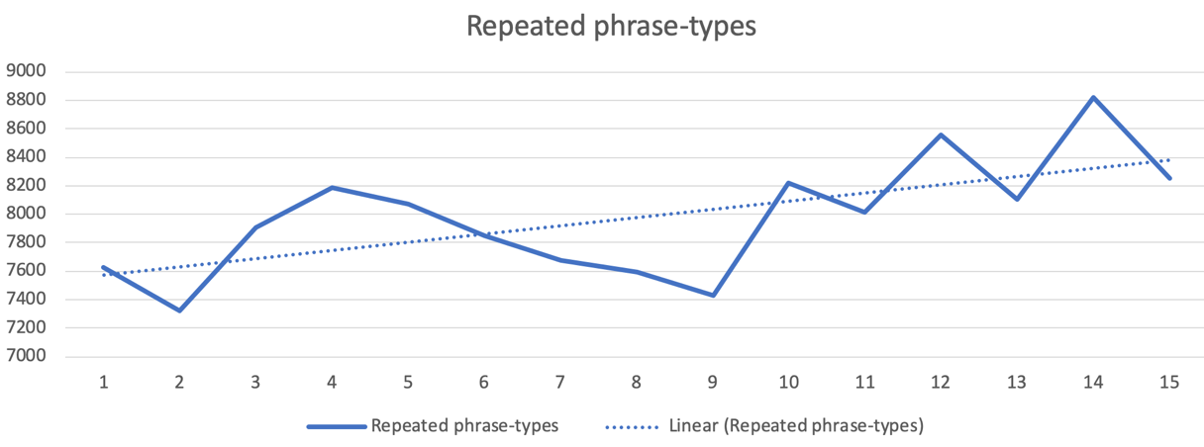
Source: Ian Lancashire and Graeme Hirst, 2019, Vocabulary Changes in Agatha Christie’s Mysteries as an Indication of Dementia: A Case Study
Notes:
OLS Regression Results ======================================================================================= Dep. Variable: Word-types R-squared (uncentered): 0.867 Model: OLS Adj. R-squared (uncentered): 0.858 Method: Least Squares F-statistic: 91.57 Date: Wed, 20 Nov 2019 Prob (F-statistic): 1.61e-07 Time: 13:29:13 Log-Likelihood: -133.33 No. Observations: 15 AIC: 268.7 Df Residuals: 14 BIC: 269.4 Df Model: 1 Covariance Type: nonrobust ============================================================================== coef std err t P>|t| [0.025 0.975] ------------------------------------------------------------------------------ Age 74.2773 7.762 9.569 0.000 57.629 90.925 ============================================================================== Omnibus: 1.630 Durbin-Watson: 0.118 Prob(Omnibus): 0.443 Jarque-Bera (JB): 0.882 Skew: -0.102 Prob(JB): 0.643 Kurtosis: 1.830 Cond. No. 1.00 ============================================================================== Warnings: [1] Standard Errors assume that the covariance matrix of the errors is correctly specified. OLS Regression Results ========================================================================================== Dep. Variable: Repeated phrase-types R-squared (uncentered): 0.927 Model: OLS Adj. R-squared (uncentered): 0.922 Method: Least Squares F-statistic: 178.7 Date: Wed, 20 Nov 2019 Prob (F-statistic): 2.32e-09 Time: 13:29:13 Log-Likelihood: -136.40 No. Observations: 15 AIC: 274.8 Df Residuals: 14 BIC: 275.5 Df Model: 1 Covariance Type: nonrobust ============================================================================== coef std err t P>|t| [0.025 0.975] ------------------------------------------------------------------------------ Age 127.3172 9.525 13.367 0.000 106.888 147.746 ============================================================================== Omnibus: 3.301 Durbin-Watson: 0.095 Prob(Omnibus): 0.192 Jarque-Bera (JB): 1.270 Skew: 0.232 Prob(JB): 0.530 Kurtosis: 1.653 Cond. No. 1.00 ============================================================================== Warnings: [1] Standard Errors assume that the covariance matrix of the errors is correctly specified. OLS Regression Results ======================================================================================= Dep. Variable: Indefinite words R-squared (uncentered): 0.931 Model: OLS Adj. R-squared (uncentered): 0.926 Method: Least Squares F-statistic: 189.3 Date: Wed, 20 Nov 2019 Prob (F-statistic): 1.59e-09 Time: 13:29:13 Log-Likelihood: 5.9482 No. Observations: 15 AIC: -9.896 Df Residuals: 14 BIC: -9.188 Df Model: 1 Covariance Type: nonrobust ============================================================================== coef std err t P>|t| [0.025 0.975] ------------------------------------------------------------------------------ Age 0.0099 0.001 13.759 0.000 0.008 0.011 ============================================================================== Omnibus: 6.358 Durbin-Watson: 0.910 Prob(Omnibus): 0.042 Jarque-Bera (JB): 3.342 Skew: 1.060 Prob(JB): 0.188 Kurtosis: 3.922 Cond. No. 1.00 ==============================================================================

Slide 7
Why revisit this?
Huge improvement in NLP algorithms and tool kits
Abundance of data
Limited scope of previous studies
Inconsistent results in literature
Controlled trials but no observational studies

Slide 8
Features used for calculating Alzheimer’s propensity
Calculated features
Number of spelling mistakes
Number of grammar mistakes
Distribution of sentence lengths (percentiles)
Distribution of e-mail lengths (percentiles)
Estimated vocabulary size
Approx grammar completeness
Approx grammar errors
Aggregated skip-gram likelihood
# Offensive words
# Indefinite nouns (“thing”, “any”, “someone”, …)
Repetitions of words and phrases
Collected data at sign-up
Age
Gender
Education level
Confirmed Alzheimer
Diagnosis date (if any)
No access to
Chronometric variables like writing speed and typing speed
Number of corrections made
Handwriting
Pen pressure or typing pressure

Slide 9
Ethical considerations
Who the hell is Faktion to diagnose Alzheimer? We are not doctors nor do we pretend to be
You need *everybody’s* e-mail for that? One in 10 people age 65 and older (10 percent) has Alzheimer's dementia. Balancing privacy with medical care and improving lives.
Are you reading our e-mails to [insert something nasty]?

Slide 10
Next steps?
Google speech stack vs. Faktion NLP / ASR with the purpose of transcribing spoken, Flemish sentences
het heel goed bekeken stop wordt er tegenwoordig vrijdag gebruikt en wel heel fijn eerst meer willen zijn van de vergadering in vlaanderen we starten in vijfenveertig weer nog procent 88 fan half 2000 nemen af en werd het eten van 26% van harte
het woord betonstop wordt tegenwoordig vrijdag gebruikt en waar we heen zijn is van de vergadering in Vlaanderen en we starten in 76 300% 88 A5 2009 half verwachten 2016 20% verhard
Notes:
Second: Speech-to-text engine, that already shows promising results.

Slide 11
GET INVOLVED
FUNDING
is a severe issue
DATA AVAILABILITY
is a severe issue

Slide 12
This is only top of the iceberg. Are you getting more
CURIOUS ?

Slide 13
CLIENT SUCCESS STORIES
Automated Document Processing by Faktion

Slide 14
THANK
YOU
FAKTION
JANUARY 28, 2019

