Slide 1
Call AI-ICON 2020
AI4Growth (28 January 2020, Gent)
Jo Bultreys

Slide 2
AI-ICON: Context
Flemish Policy Plan Artificial Intelligence (32 M euro / year)
Research
= strengthening of the top strategic basic research AI in Flanders
Adoption by companies
= implementation in the Flemish economic fabric
Accompanying policy
= awareness raising, training, ethics, …
AI-ICON = > the bridge between pillars 1 & 2

Slide 3
ICON: Research part + company part
Research part…
≈ Strategic Basic Research (SBO) project
= clear knowledge development, high risk, broad potential for valorisation
min. 1 Flemish research institution, 100% support
… and company part …
≈ VLAIO Research Project
= industrial research (experimental development)
min. 3 Flemish companies, min. 60% of the project budget, typically 50% support
… completed in genuine cooperation

Slide 4
AI-ICON 2020: Timing
9 december
oproep open
9 maart
matchmaking
21 april
vooraanmelding
7 juli
full proposal
19 november
beslissing
nu
2019
dec
jan
feb
maa
apr
mei
jun
jul
aug
sep
okt
nov
2020
projectgenese
feedback
evaluatie
project
matchmaking event: 9 maart | Lamot, Mechelen | AI-ICON, CS-ICON en AI & CS
www.vlaio.be/ICONinteresse

Slide 5
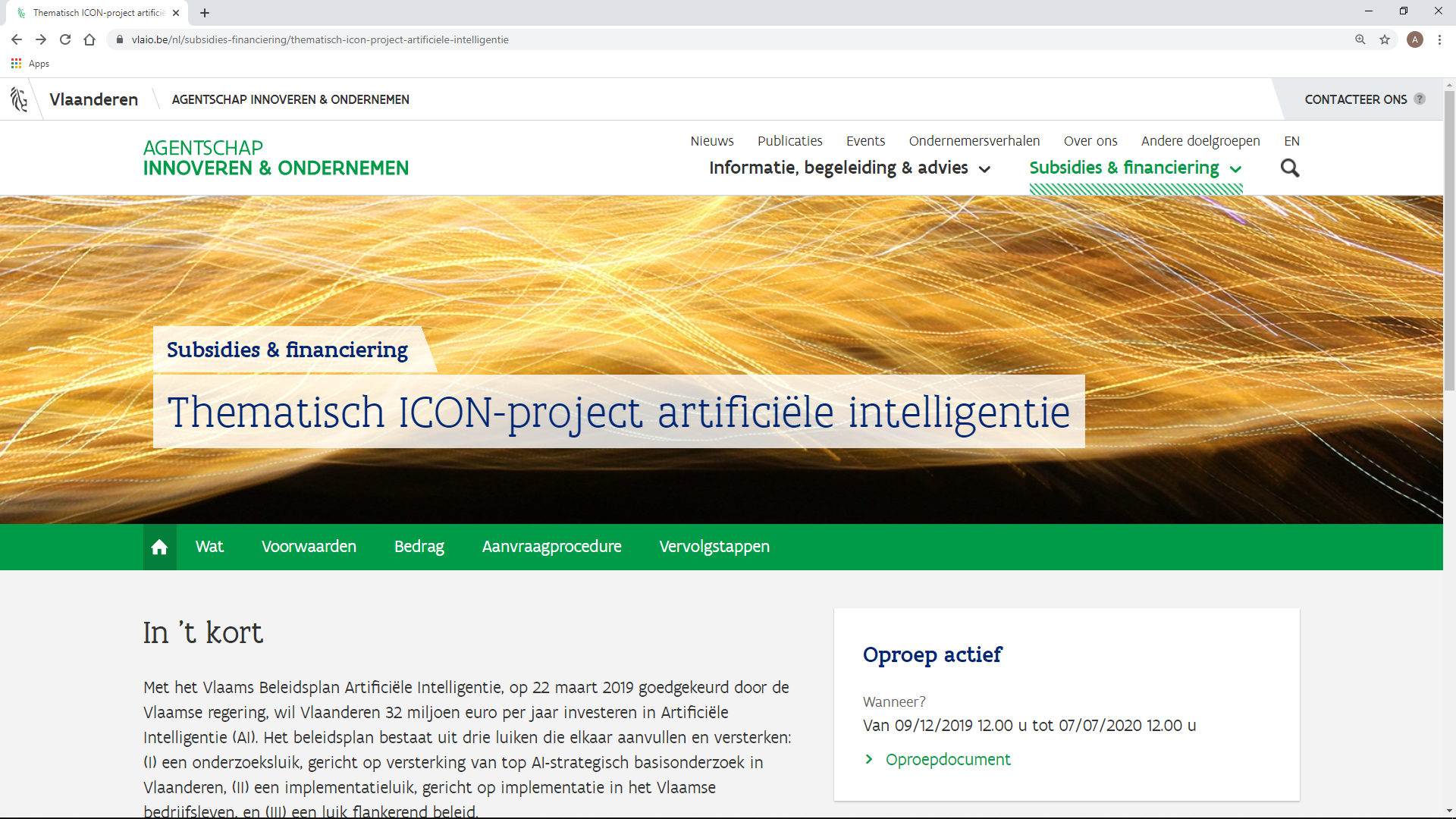
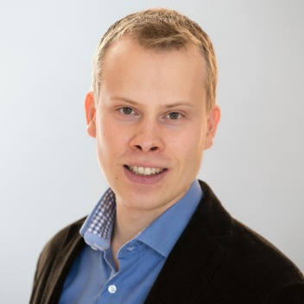
Contact us
www.vlaio.be/ai-icon
ai-icon@vlaio.be
matchmaking event
9 March | Lamot, Mechelen
AI-ICON, CS-ICON, AI & CS
www.vlaio.be/ICONinteresse
Jo.bultreys@vlaio.be
Ares Lagae (ares.lagae@vlaio.be)

